Slide 1
X Education - Lead Scoring Case Study
Identification of Hot Leads to focus more on them and thus enhancing the conversion ratio for X Education
Group Members:
Neethu Radhakrishnan
Ramalingeswara Rao

Slide 2
Background
X Education , An education company named sells online courses to industry professionals
Many interested professionals land on their website
The company markets its courses on several websites like Google. Once these people land on the website, they might browse the courses or fill up a form for the course or watch some videos
X Education Company

Slide 3
Background
When these people fill up a form providing their email address or phone number, they are classified to be a lead
Once these leads are acquired, employees from the sales team start making calls, writing emails, etc. Through this process, some of the leads get converted while most do not.
The typical lead conversion rate at X education is around 30%
X Education Company

Slide 4
Problem Statement
X Education gets a lot of leads but its lead conversion rate is very poor
To make this process more efficient, the company wishes to identify the most potential leads, also known as ‘Hot Leads’.
If they successfully identify this set of leads, the lead conversion rate should go up as the sales team will now be focusing more on communicating with the potential leads rather than making calls to everyone
X Education Company’s Problem

Slide 5
Problem Statement
We will help them to select the most promising leads, i.e. the leads that are most likely to convert into paying customers.
We are required to build a model wherein we need to assign a lead score to each of the leads such that the customers with higher lead score have a higher conversion chance
The CEO, in particular, has given a ballpark of the target lead conversion rate to be 80%.
X Education Company’s Problem

Slide 6
Proposed Solution
Selection of Hot Leads
Communicating with Hot Leads
Conversion of Hot Leads
Leads Clustering
We cluster the leads into certain categories based on their tendency or probability to convert, thus, getting a smaller section of hot leads to focus more on.
Focus Communication
Since we would have a smaller set of leads to have communication with, we might make more impact with effective communication.
Increase conversion
Since we focussed on hot leads, which were more probable to convert, we would have a better conversion rate, and hence we can achieve the 80% target.

Slide 7
Solution
For our Problem Solution, the crucial part is to accurately identify hot leads.
The more accurate we obtain the hot lead, the more chance we get of higher conversion ratio.
Since we have a target of 80% conversion rate, we would want to obtain a high accuracy in obtaining hot leads.
Selection of Hot Leads

Slide 8
Implementation

Slide 9
Loading & Observing the past data provided by the Company
Univariate, Bivariate, and Heatmap for numerical and categorical columns
Performing pre-requisites for RFE and Logistic Regression
Data Gathering
Data Cleaning
Performing EDA
Model Building
Data Preparation
Duplicate removal, null value treatment, unnecessary column elimination, etc.
Outlier Treatment, Feature-Standardization

Slide 10
Reduction of columns and Model re-building
Selection of top 2 features using RFE
Feature Selection
Model Building
Model Improvement
Final Model
Model building using RFE for selected columns
Final Model Analysis and performance on Test Data

Slide 11
Plots (Visualization)

Slide 12
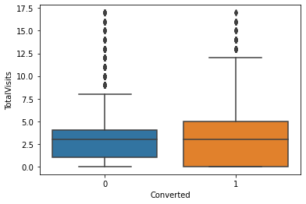
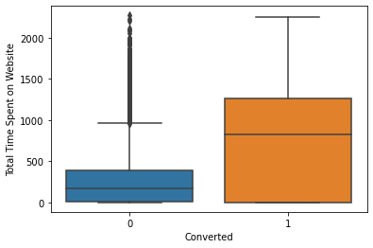
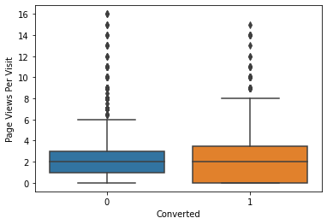
EDA plots depicting variation in numerical columns for those who Converted and those who didn't.

Slide 13
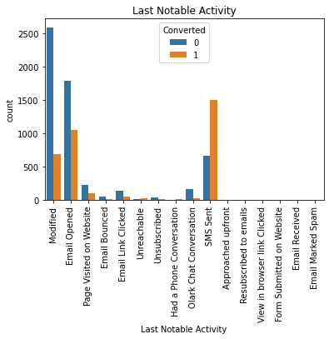
EDA plots depicting variation in categorical column (Last Notable Activity) for those who Converted and those who didn't.

Slide 14
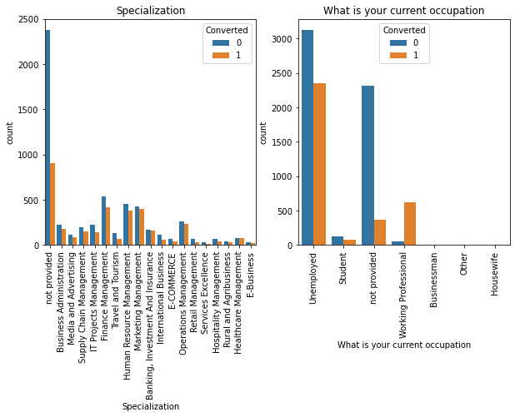
EDA plots depicting variation in categorical column (Specialization, What is your current occupation) for those who Converted and those who didn't.

Slide 15
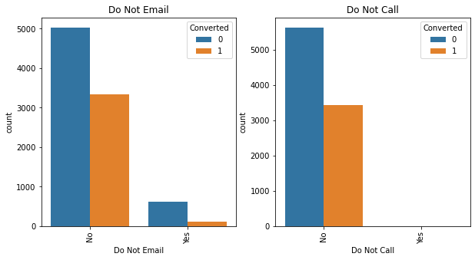
EDA plots depicting variation in categorical column (Do Not Email, Do Not Call) for those who Converted and those who didn't.

Slide 16
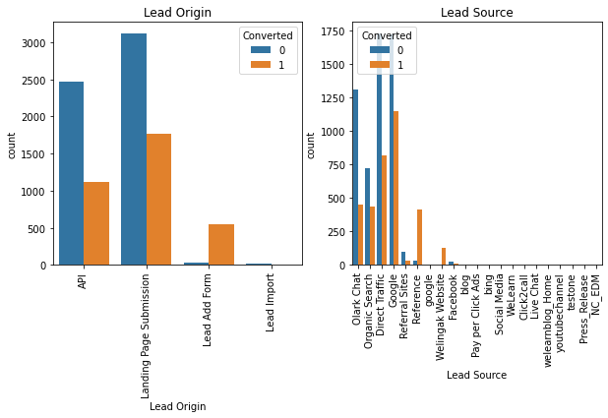
EDA plots depicting variation in categorical column (Lead Origin, Lead Source) for those who Converted and those who didn't.

Slide 17
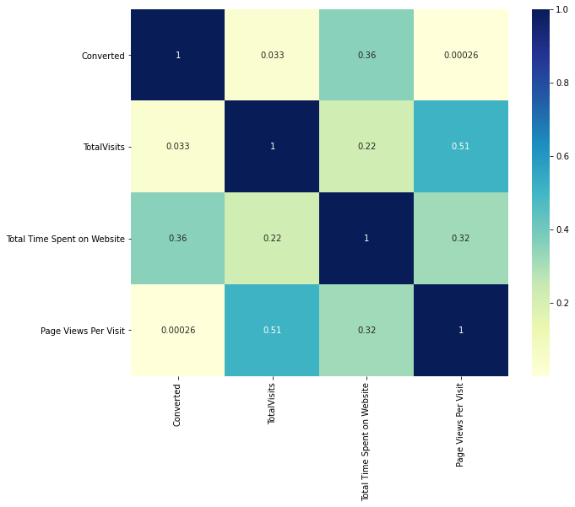
EDA plots depicting correlation (Heat Map) of all selected numerical columns.

Slide 18
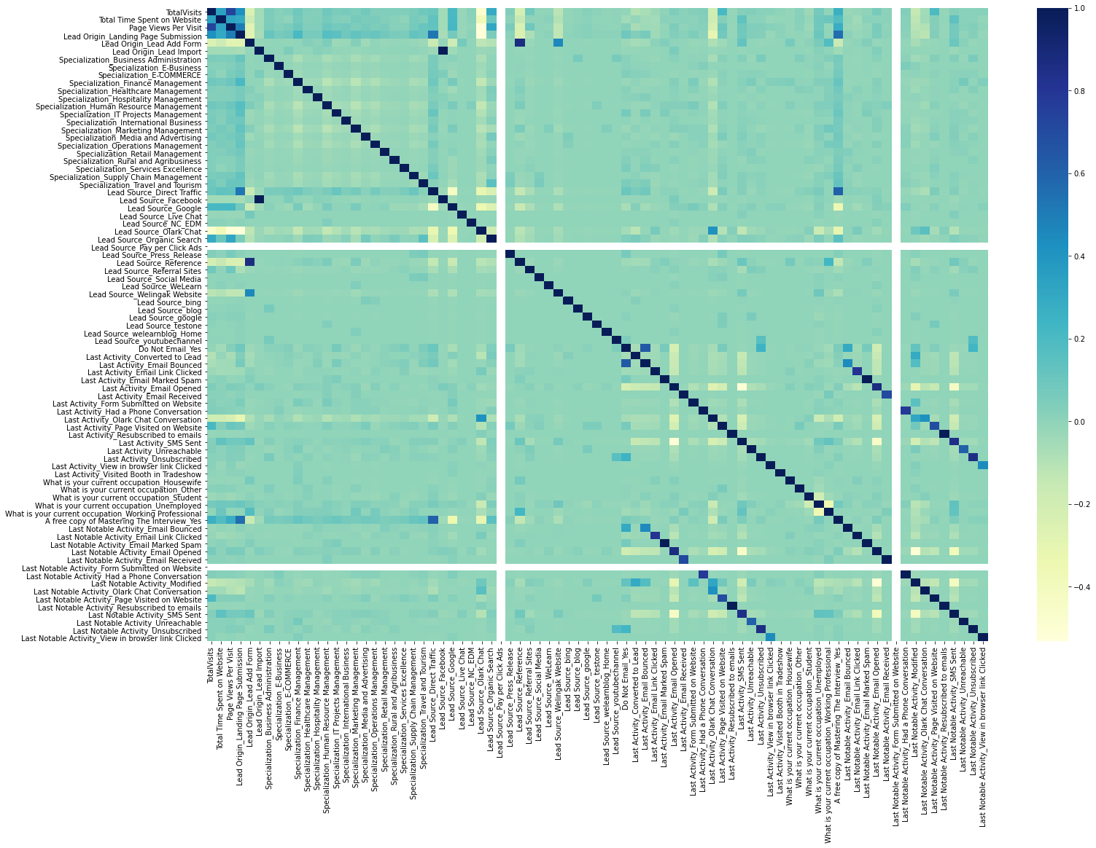
EDA plots depicting correlation (Heat Map) of all selected columns (numerical columns and dummy columns).

Slide 19
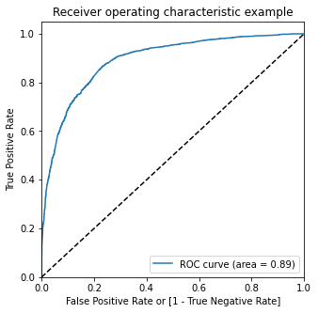
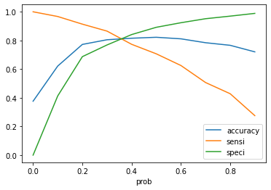
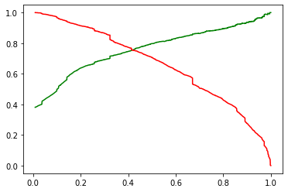
Linear Regression Final Model Parameters
Area under ROC = 0.89
Intermediate cut-off = 0.35
Final cut-off = 0.41

Slide 20
Inference / Conclusion

Slide 21
Model Analysis
Overall accuracy on Test set: 80.4
Sensitivity of our logistic regression model: 80.4
Specificity of our logistic regression model: 80.6
Performance of our Final Model

Slide 22
Inferences from Model
Top variables in model, that contribute towards lead conversion are:
TotalVisits
Lead Source_Google
Lead Source_Direct Traffic
What is your current occupation_Unemployed
Total Time Spent on Website
Last Notable Activity_Modified
Lead Source_Organic Search
Last Activity_Olark Chat Conversation
Last Notable Activity_Email Opened
Business Insights Derived from our Model

Slide 23
Inferences from Model
Lead Origin_Lead Add Form
Last Notable Activity_Olark Chat Conversation
What is your current occupation_Working Professional
Lead Source_Welingak Website
Do Not Email_Yes
Last Notable Activity_Page Visited on Website
Lead Source_Referral Sites¶
What is your current occupation_Student
Last Notable Activity_Email Link Clicked
Business Insights Derived from our Model

Slide 24
Conclusion 1 (LR Model)
Our Logistic Regression Model is decent and accurate enough, with 80.4 Accuracy on Test Set, 80.4 % Sensitivity and 80.6 % Specificity.
We can vary these parameters by varying the cut-off value and thus predict Hot leads based on scenarios like availability of extra resources and vice-versa.

Slide 25
Conclusion 2 (Recommendation)
X Education Company needs to focus on following key aspects to improve the overall conversion rate:
Increase user engagement on their website since this helps in higher conversion
Increase on sending SMS notifications since this helps in higher conversion
Get Total visits increased by advertising etc. since this helps in higher conversion
Improve the Olark Chat service since this is affecting the conversion negatively

